Slide 1
SuperPoints
REESE WILLIAMS
JOHN HOANG | OLIVER JANG | HENRY JIANG | HARMAN MINHAS

Slide 2
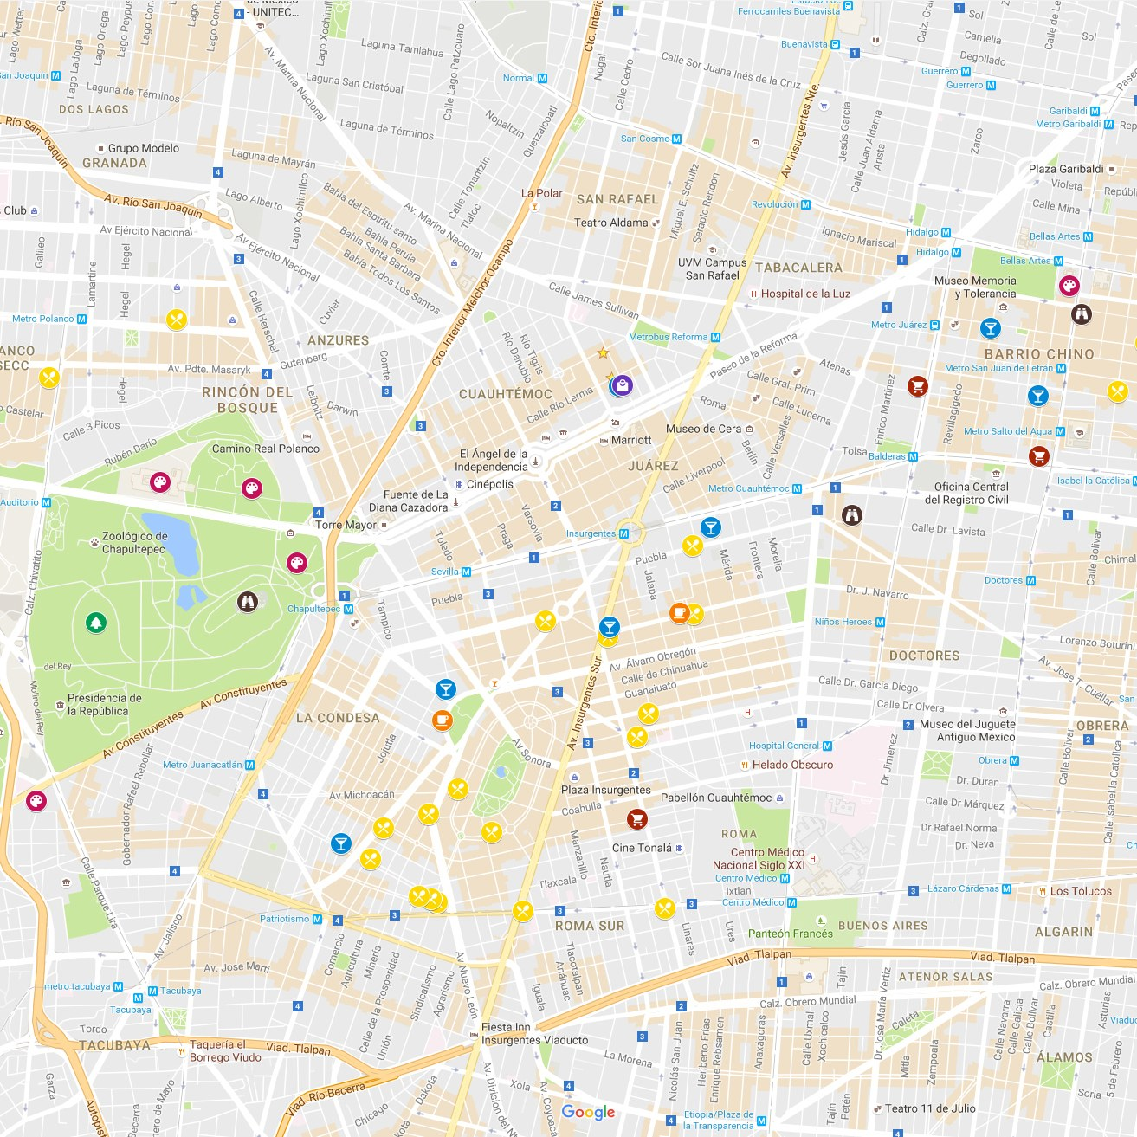



The Idea

Slide 3



Slide 4
What
We
Did
Created detection of a customer within a store Created detection of a businesses within a consumers area
Awarded points to be used for promotions

Slide 5
demo

Slide 6
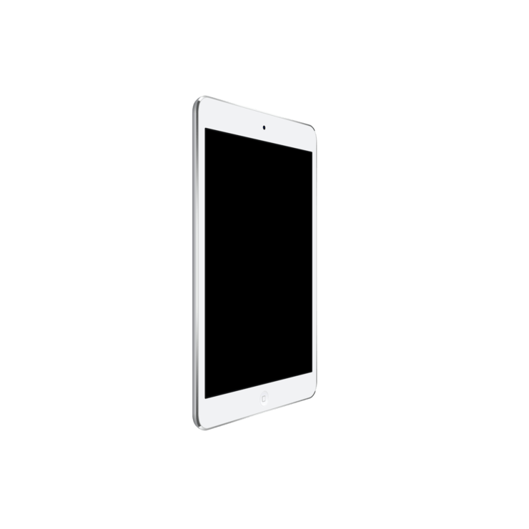
The
Future
SuperPoints
Modern design
More business value
Production

Slide 7
challenges
devices
school

Slide 8
?

